Slide 1
NE 75th Street Road Safety Corridor
July 25, 2013
1:00 pm to 3:00 pm

Slide 2
Agenda
Agenda
NE 75th Street Road Safety Corridor
1:00 Welcome and Announcements
1:05 Recap of Spring Meetings
1:15 SDOT Presentation with Q & A
2:15 Speak Directly with SDOT
3:00 Adjourn

Slide 3
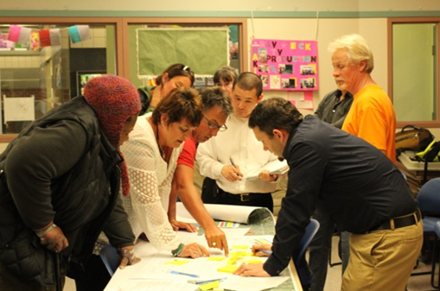
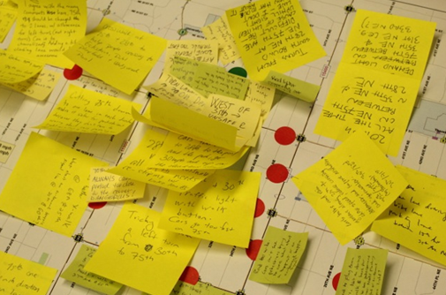
Agenda
Spring Meetings Recap
NE 75th Street Road Safety Corridor
What We Heard:
-Channelization improvements requested
-Speeding an issue area-wide
-Strong desire to improve pedestrian and bicycle safety
-Reduce conflicts at signalized intersections
-Congestion leads to cut thru traffic on neighborhood streets
-More enforcement needed
Photos used with permission from Ravenna Blog

Slide 4
Existing Conditions
NE 75th Street between 15th Avenue NE and 35th Avenue NE
Adjacent Land Uses
Single family residential with some multi-family housing
Commercial uses at 25th and 35th
Schools
Transit Service

Slide 5
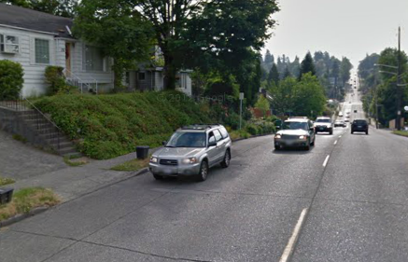
Roadway Configuration
NE 75th Street between 15th Avenue NE and 35th Avenue NE
Under-utilized on-street parking makes NE 75th Street function as a 4-lane arterial street most of the day

Slide 6
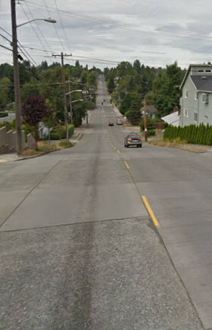
Parking Utilization
NE 75th Street between 15th Avenue NE and 35th Avenue NE
Study 1 – weeknight after 8 pm
23 parked cars total
18 near 28th Ave NE
for access to Wedgwood Pool
5 parked cars elsewhere
Study 2 – Saturday at 5 am
8 parked cars
Study 3 – weekday at 1 pm
1 parked car

Slide 7
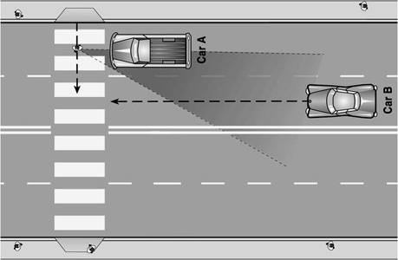
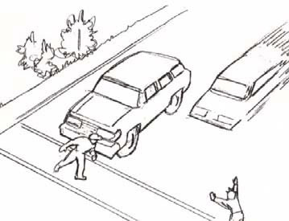
Multiple Threat
NE 75th Street between 15th Avenue NE and 35th Avenue NE
One vehicle stops for a pedestrian on a multi-lane road, but the motorist in the next lane does not, resulting in a crash.

Slide 8
Traffic Operations
NE 75th Street between 15th Avenue NE and 35th Avenue NE
Video: NE 75th Street at 30th Avenue NE looking west

Slide 9
NE 75th Street - Data
Traffic Data
NE 75th Street between 15th Avenue NE and 35th Avenue NE
Traffic Volume
20,100 average weekday traffic at 12th Avenue NE
14,700 average weekday traffic at 30th Avenue NE
Speed (posted speed limit is 30 mph)
34 mph eastbound
37 mph westbound
Collisions
114 total collisions last three years, 50+ injuries
Notes:
Volume
-20,100 at 12th Avenue NE
-14,700 at 30th Avenue NE
*explain roadway capacity/channelization*
Speed
Posted speed limit = 30 mph
34 mph EB
37 mph WB
Collisions
114 total collisions last three years, 49 injuries, 2 serious injuries, and 2 fatalities
Leading collision type = left turns, angles, rear end (in descending order)

Slide 10
Goals
Improve safety for all modes
Improve channelization
Improve pedestrian and bicycle mobility
Maintain acceptable level of service for
vehicular traffic
Performance Monitoring
SDOT to conduct before and after studies

Slide 11
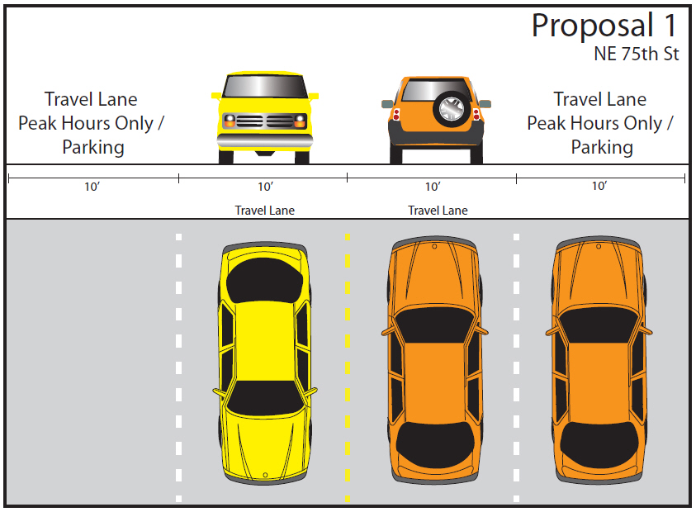
Proposal 1
NE 75th Street between 15th Avenue NE and 35th Avenue NE
Notes:
Review key features, limitations, and changes to level of service

Slide 12
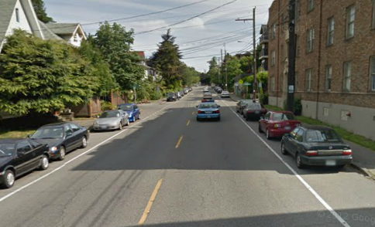
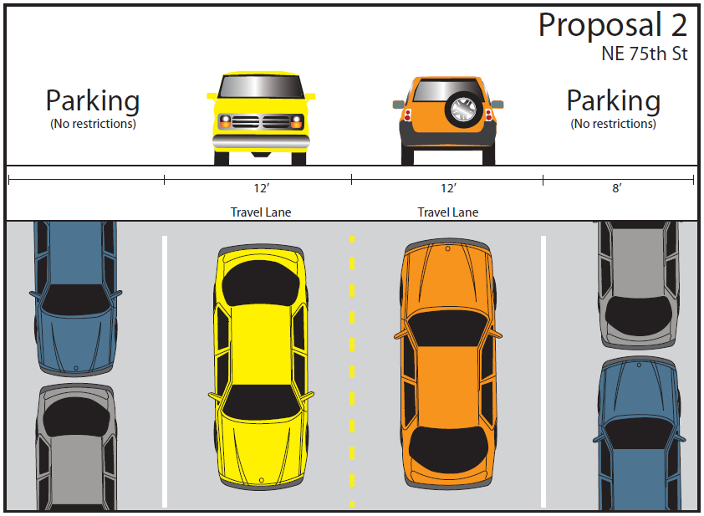
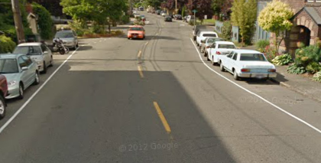
Proposal 2
NE 75th Street between 15th Avenue NE and 35th Avenue NE
12th Avenue E
Notes:
Review key features, limitations, and changes to level of service

Slide 13
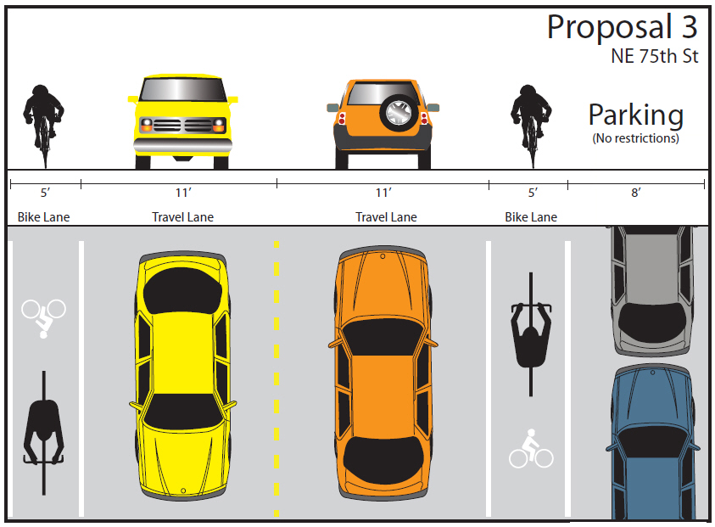
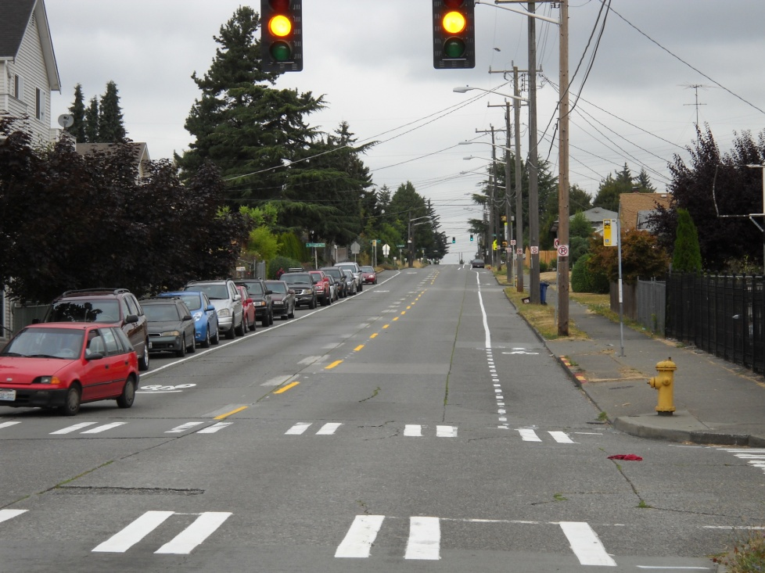
Proposal 3
NE 75th Street between 15th Avenue NE and 35th Avenue NE
15th Avenue S
Notes:
Review key features, limitations, and changes to level of service

Slide 14
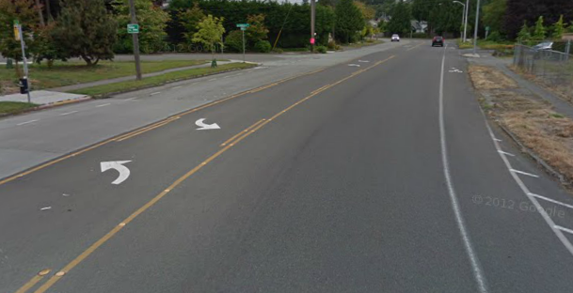
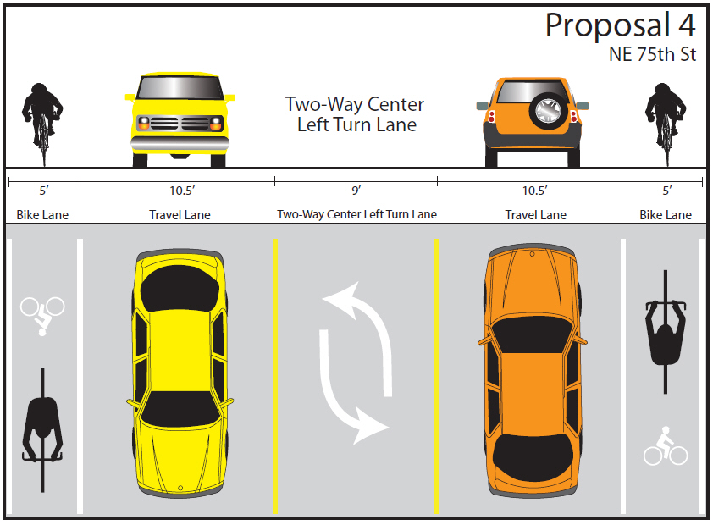
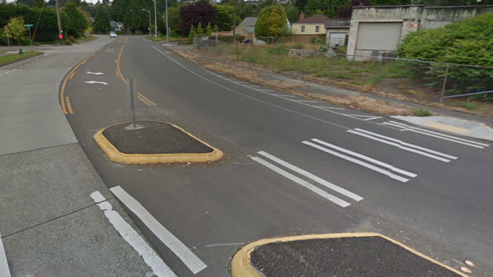
Proposal 4
NE 75th Street between 15th Avenue NE and 35th Avenue NE
Fauntleroy Way SW
Notes:
Review key features, limitations, and changes to level of service

Slide 15
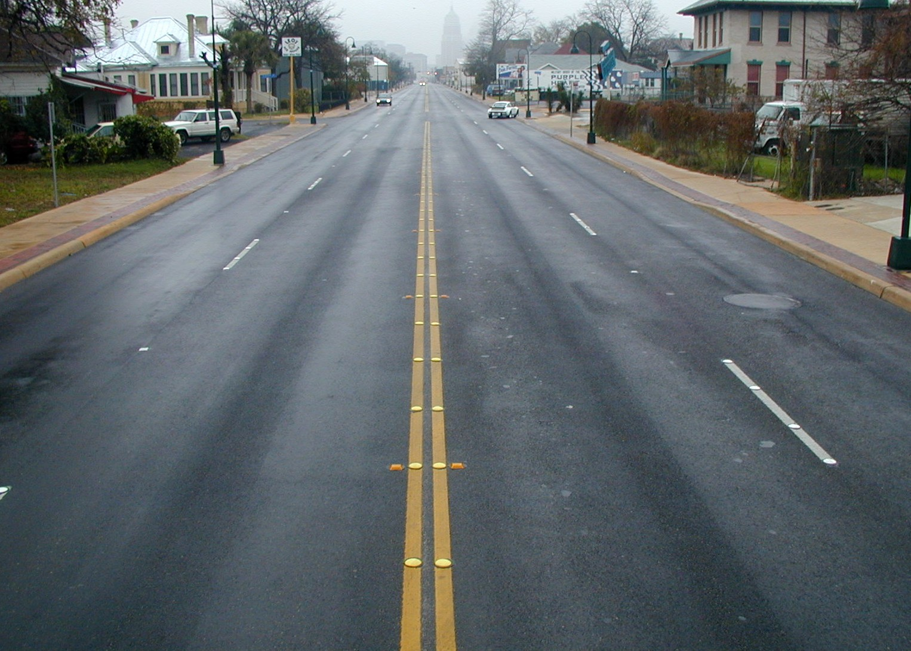
Notes:
Complete Streets approach to retrofitting roadways
Multi-modal improvements-moving people and goods (not just cars)
Here’s a 4 lane

Slide 16
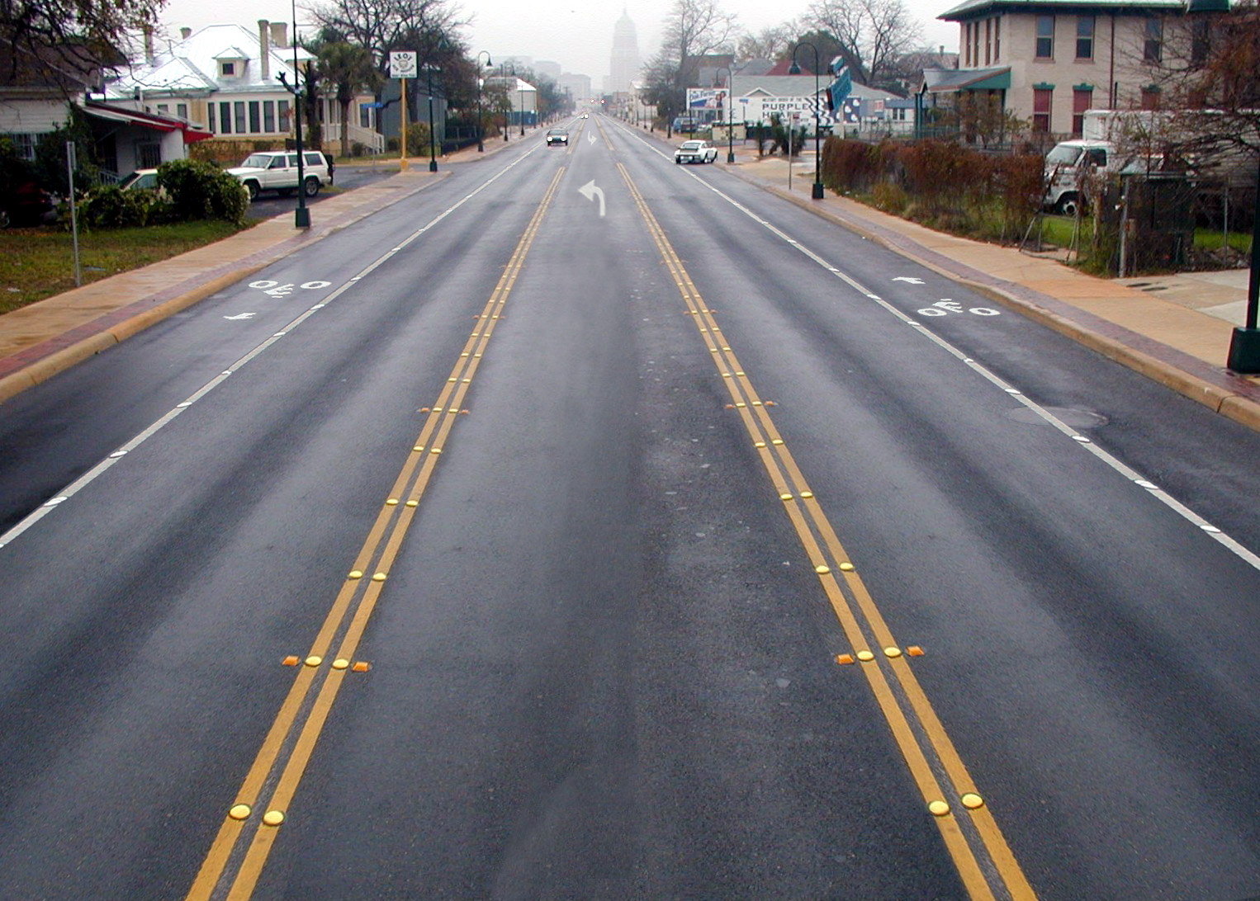
Notes:
Dedicated two-way-left-turn-lane
Dedicated bicycle lanes

Slide 17
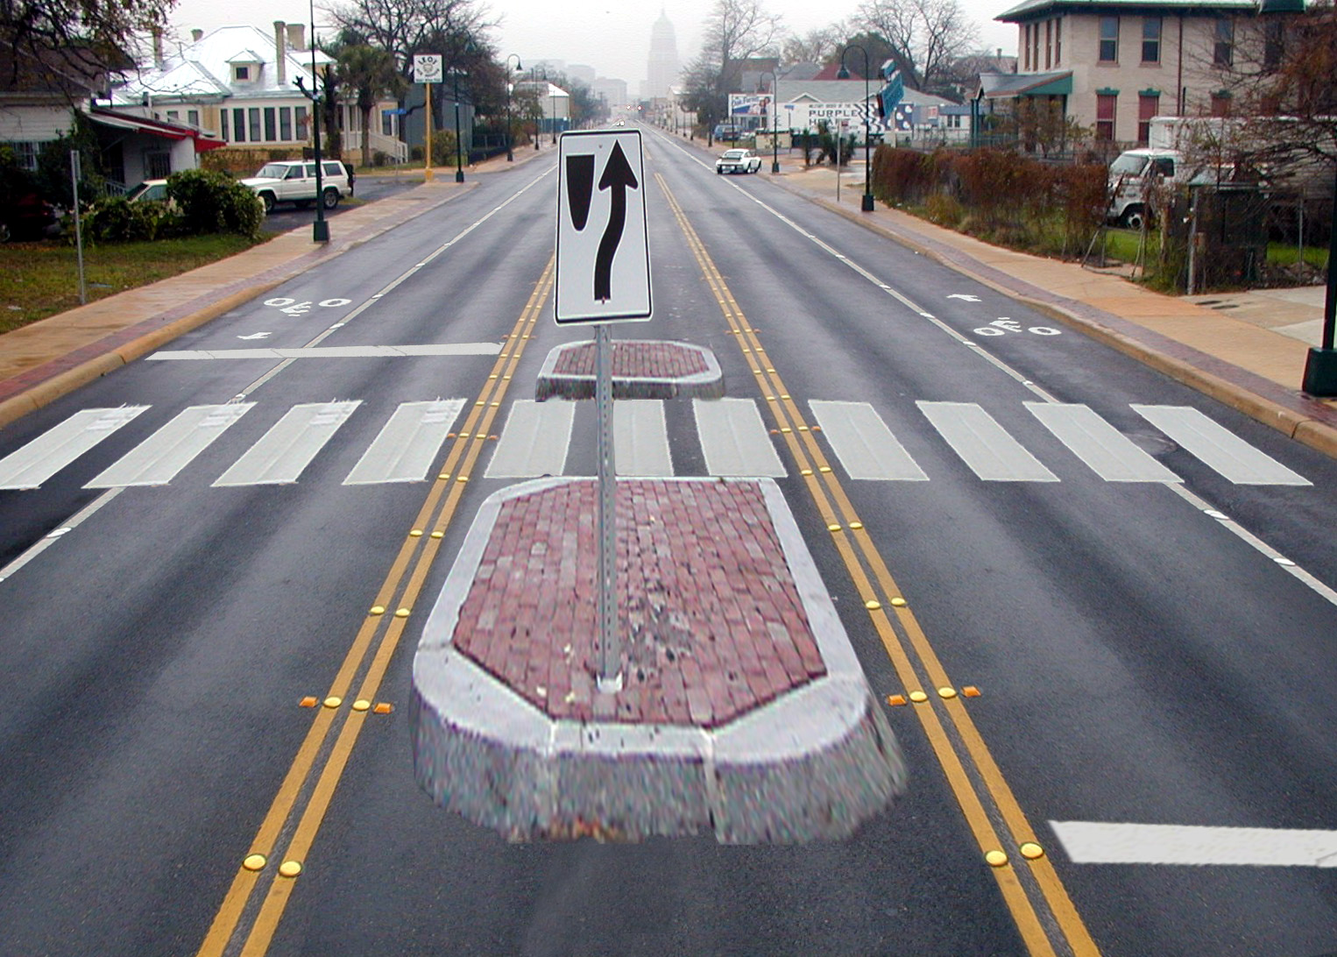
Notes:
Pedestrian refuge and crosswalk
Business district improvement
Easier to mark pedestrian

Slide 18
Recent Results
Street | ADT begin | ADT change | Collisions | 85th % | Top end speeders | Travel time
Stone Way | 13,000 | -6% | - 14% | - 6% | - 80% | N/A
Nickerson St | 18,600 | - 1% | - 23% | - 21% | - 94% | N/A
Columbian Way | 11,200 | + 20% | No change | - 6% | -50% | N/A
NE 125th St | 16,200 | + 4% | N/A | - 8% | - 69% | + 1.5 min
Data clearly indicates that Proposal 4 will reduce speeding and collisions without significantly
affecting travel times

Slide 19
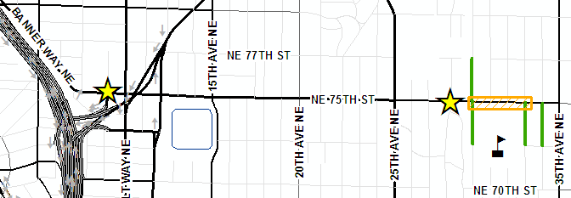
Additional Improvements
Photo enforcement cameras for Eckstein School Zone
Traffic calming in neighborhoods near Eckstein
Crossing Improvements
new crosswalk at 28th Ave NE with rapid flashing beacons
enhancements at existing crosswalk at 9th Ave NE

Slide 20
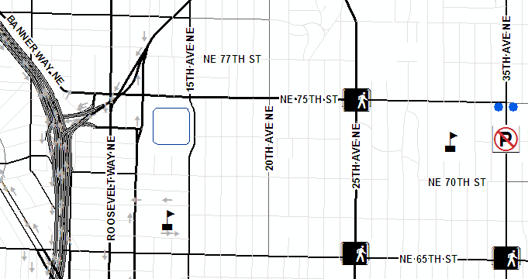
Additional Improvements
Pedestrian countdown signals
Spot parking restrictions and commercial access improvements
Encroachment and overgrown vegetation remediation

Slide 21
Longer-term Improvements
Banner Way/NE 75th Street Improvements
(west of 15th Ave NE)
Left turn pockets on 35th Ave NE at NE 75th St
Bicycle facilities east of 35th Ave NE

Slide 22
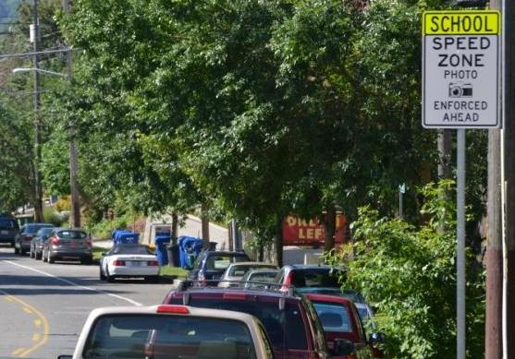
Education and Enforcement
Education
Transportation forums
School-specific instruction
Enforcement
Continued emphasis patrols
More parking enforcement
Photo Enforcement at Eckstein

Slide 23
Questions?

Slide 24
Contact Information
Dongho Chang, City Traffic Engineer
206-684-5106
dongho.chang@seattle.gov
Jim Curtin, Traffic Safety Coordinator
206-684-8874
jim.curtin@seattle.gov

